Slide 1


Slide 2

Welcome
Second Community Forum Meeting
Great feedback from the first CFM
Need within the new park landscape
New structure but a loss of key forums

Slide 3
Agenda
The Community Forum
FoCPP Update
CPPT Update
National Sports Centre Update
Regeneration Plan Statement
Community Development – Community Projects
Q&A
Next Steps

Slide 4
The Community Forum
Why so important?
Objectives and format of the meeting
Grow and change
Two way communication and practically working together

Slide 5
FoCPP Update
CIO
Members
  Individuals
  Organisations
Upskilling and recruiting new trustees and partners
Building a relationship with the CPPT

Slide 6
The role of the FoCPP
FoCPP key stakeholder in the past
Need to take a bigger role
  Communication
  Volunteering
  Community development
  Accountability

Slide 7
Crystal Palace Park Trust Update
Three key parts to the future
New Governance
Sustainable Business Plan
Regeneration Plan

Slide 8
CPPT Aim
The overarching aim of the Trust is to protect, manage and improve Crystal Palace Park as a green, historic, ecological, recreational, sporting, cultural and educational resource in the interests of the community and other park users.
Our Progress to Date…

Slide 9
2016
2017
ADVISING BROMLEY COUNCIL ON PARK REGENERATION
2018
REGISTERING THE CRYSTAL PALACE PARK TRUST AS A CHARITY AND CREATING AN OVERARCHING VISION
WORKING GROUP SELECTED THROUGH INDEPENDENT PROCESS
DEVELOPING PROGRAMMES FOR THE LONG TERM BENEFIT OF THE PARK
2019+

Slide 10
CPPT Objectives
Securing a Sustainable Future
Delivering a Vision
Welcoming for All
Conserving the Park’s Heritage Assets
Enhancing the Environment
A Place for Learning
Supporting Skills & Economic Development
A Place for Recreation & Enjoyment
A Place for Health & Well-being

Slide 11
CPPT Ways of Working
ENGAGE: through communication and involvement with the local community
EXPLORE:
Seek new and innovative ways of support
from stakeholders in developing a sustainable future for the park.
ENHANCE:
By supporting community groups
and volunteers working in the interests of the park and meeting the Trust’s aim and objectives.

Slide 12
Crystal Palace Park Trust Update
We are a Trust!
Branding coming - working with local designer Kate Roncoroni
FoCPP relationship
Maintenance and Management client in new contract
Community Projects!

Slide 13
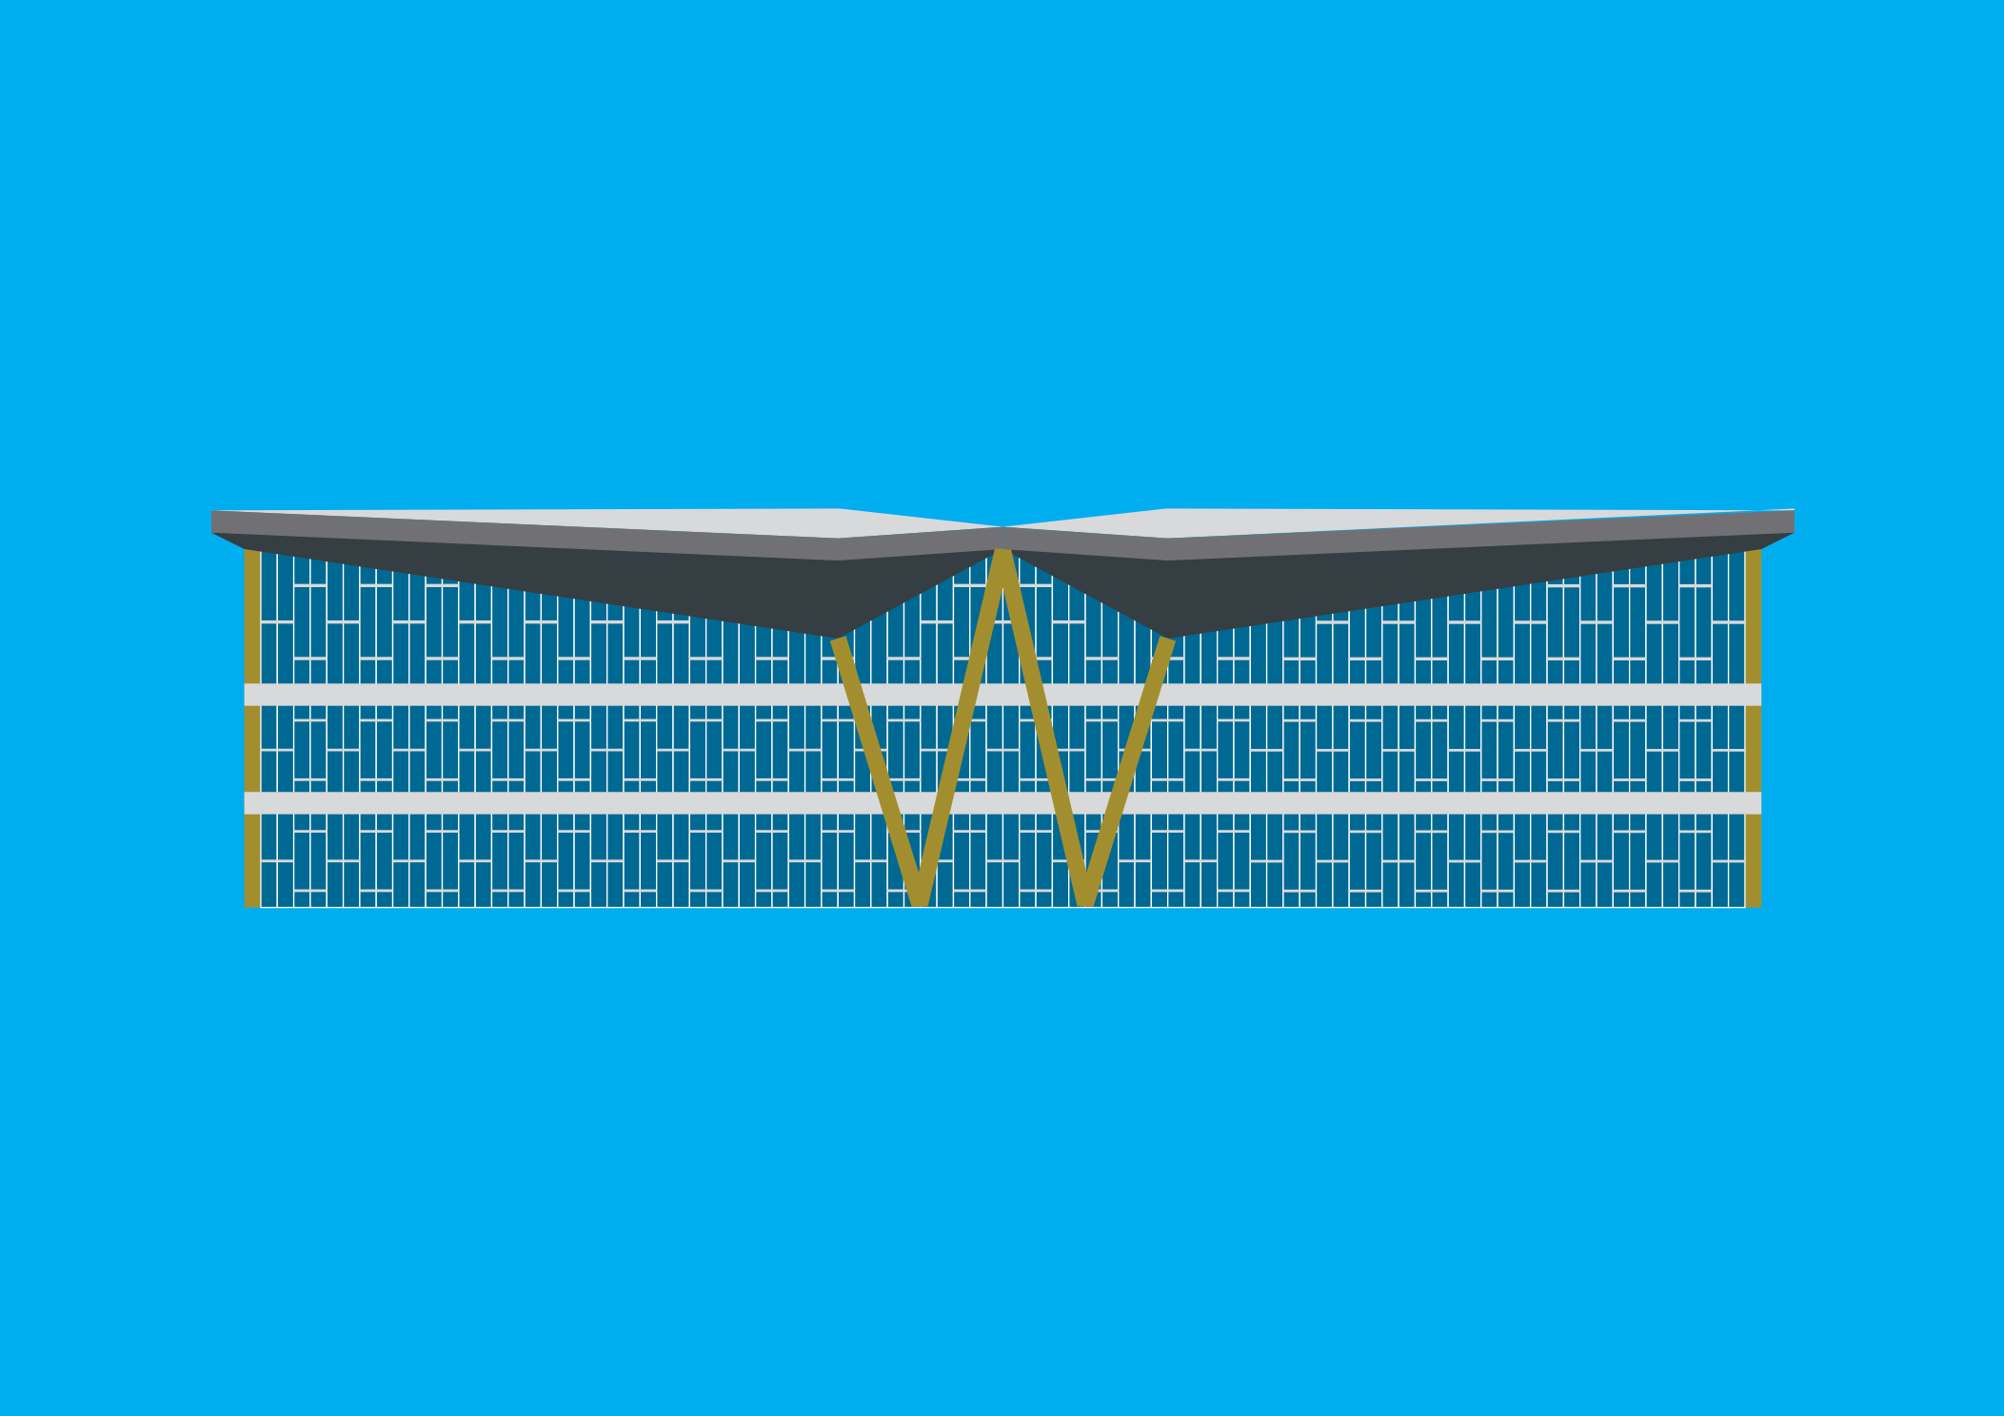
NSC SPORTING FACILITY ASSESSMENT
INTERIM REPORT

Slide 14
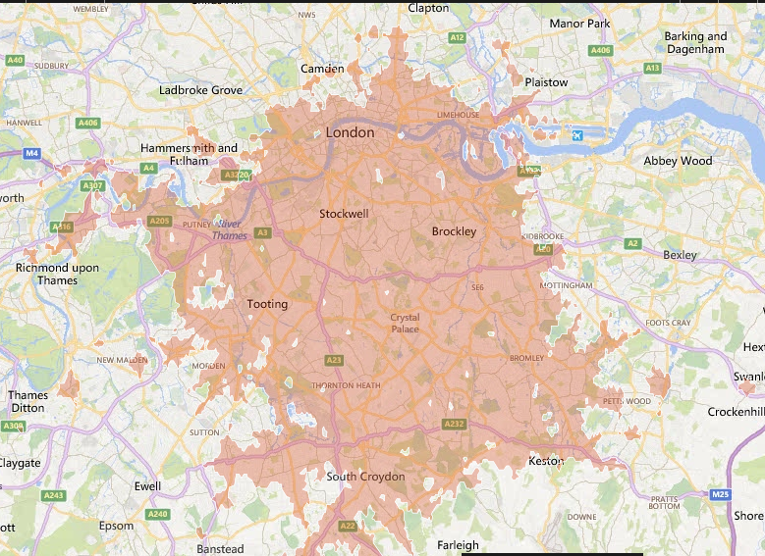
LOCATION

Slide 15
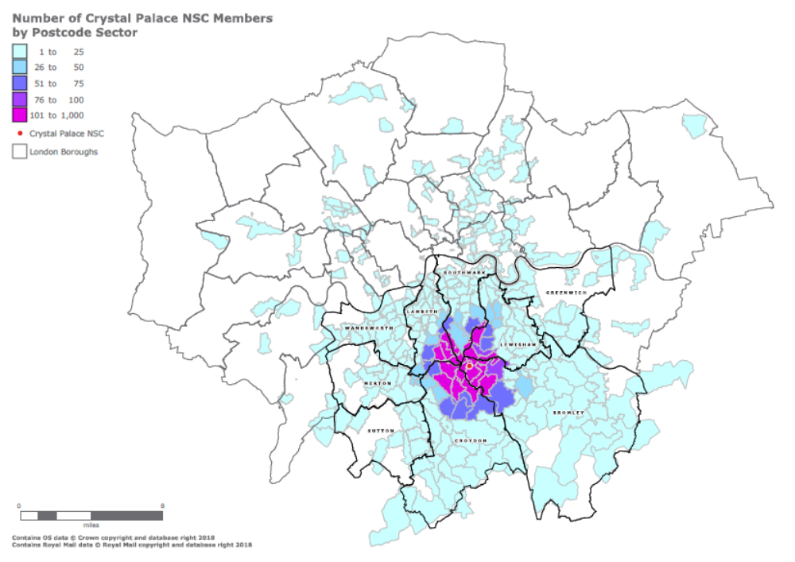

LOCATION

Slide 16
CONSULTATION
Crystal Palace Sports Partnership
Open Forums
Focus Groups
National Governing Bodies
Club and User Groups (current and potential)
Neighbouring Local Authorities
Others…………

Slide 17
ATHLETICS
Key Findings:
Poor condition & deteriorating
2012 - last international event
UKA committed to London Stadium
No realistic prospect of major athletics events
Stages school sports days,
London Youth Games, etc
Indoor centre - one of three in South London (five in North London)
Indoor building in poor condition
‘Mixed economy’ of club use and coach-led training groups
Future needs:
Significantly reduce spectator capacity
General refurbishment
Still a valuable asset for competition up to regional level
Pricing and marketing to reflect regional role
Indoor training facilities for sprinting, hurdles, jumps and throws
Support for the sports development efforts
Involvement of users in setting appropriate policies and procedures.

Slide 18
AQUATICS
Key Findings
CP has unique scale of provision with dedicated pools for different swimming activities
Dedicated pools has created unique programme of use
CP dedicated club/centre for diving but network of swimming clubs no CP swimming club
Programme of use variable – schools swimming not extensive, learn to swim very extensive
CP does not compete with extensive network of local community pools in 5 boroughs.
Governing body strategies explicit on need to keep CP aquatics
Future Needs
Must be explicit on aquatics provision and programme of use consistent with CP vision which is sport development – beginners to elite
Need to retain all programmes of use but options how this is done.
Need to retain learn to swim capacity
Support diving investment. Quality improvements – e.g. changing accommodation

Slide 19
SPORTS HALL
Key Findings:
CP has unique scale of provision with main arena (8 badminton courts) and north balcony (4 courts). Plus spectating for up to 1,500.
Issue for clubs in finding dedicated venues for club development – CP offers real scope.
Physical/environmental improvements needed
Future Needs:
SCALE of provision and ancillaries are fine – no need to increase scale.
Quality must be improved – repair leaking roof. Events not coming to CP because of roof and injury to participants
Improve floor surfaces – for compatible sports. Improve changing accommodation quality
Clubs want dedicated venue for participation/club development/training/events – for winter season. Very clear evidence of need and real scope to develop.

Slide 20
OUTDOOR SPORTS
Key Findings:
Significant demand for improved and additional hockey pitches.
Demand for improved football pitches.
Future Needs:
Elements of outdoor provision; hockey and beach volleyball fit the model of club and sports development and represent key strategic provision.
The remaining outdoor elements are important in terms of the overall multi-sport activity offer and provide important opportunities for community recreation and income generation opportunities.

Slide 21
NEXT STEPS
This work sets a baseline
Continue to strengthen links with NGBs and Sport England
Next stage - technical and procurement feasibility; delivering the needs
More detailed engagement and consultation – August onwards
NSC@london.gov.uk

Slide 22
Regeneration Plan Statement
While the submission of the Outline Planning Application has been delayed, it is going ahead as intended. The key reason behind the delay has been the necessity to put together a strong Enabling Development case for Historic England and the planning authority, which achieves the right balance of heritage benefit and community benefit within the budget generated by the capital receipts. An Enabling Development case is required to justify residential development on Metropolitan Open Land and subsequent loss of parkland. It is subject to a final discussion with Historic England at the beginning of July, which will help define the OPA, due for submission during the summer.
Contact: cppregeneration@bromley.gov.uk with any queries or
feedback

Slide 23
Larger scale Community Projects
CPPT and FoCPP are keen to work together to deliver larger scale community projects
Build on the legacy of the Community Projects fund
Key parts of the regeneration plan not currently funded
Key opportunity to shape the park together

Slide 24
Larger scale Community Projects
Visitors / Information centre
Concert platform
Playgrounds / Recreation
Wayfinding
Heritage education

Slide 25
Larger scale Community Projects
Thoughts
Questions
Support
Challenges….
CPPT and FoCPP will review the suggestions and feedback at the next forum in September

Slide 26
Next Steps
Become a member
Tell us how you want to get involved
Tell us what you think or what’s on your mind
Have another drink
Come back in September

